Slide 1
Tether Control of UAV
Building a Platform for Tether Control of UAV’s
BSc. Project Peter J. Savnik Advisor: Søren Hansen Jens C. Andersen
Notes:
Unmanned Aerial Vehicles (UAVs), also known as “drones”, have been attracting an increasing amount of attention as low cost aerial service robots. Although the high speed and maneuverability of multirotor UAVs make them attractive for many applications, a common drawback for this type of aircraft is their limited flight time. The “tethered” configuration consists in connecting the multirotor drone to a ground station by means of a cable. By using the cable as a power line, the Tethered UAV can potentially achieve an unlimited flight-time.

Slide 2
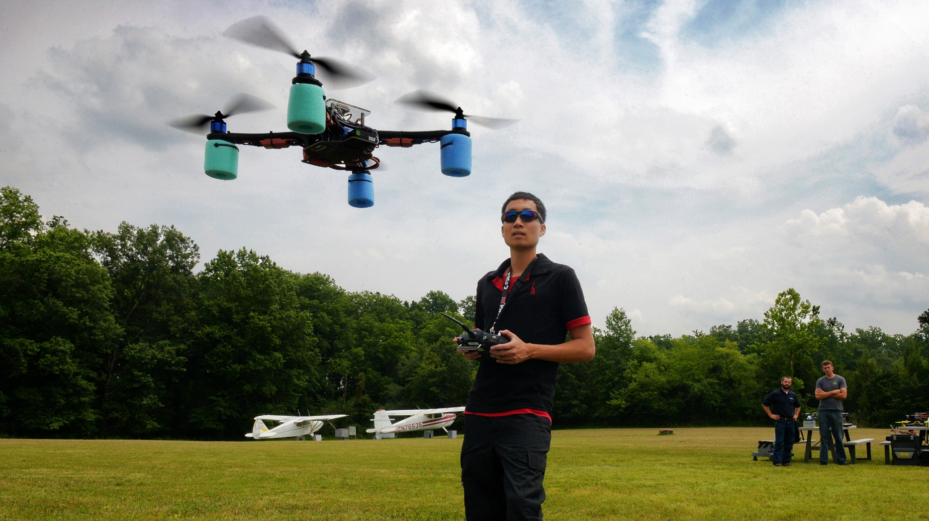
Hobby/Research » Industrial Application
Add Presentation Title in Footer via ”Insert”; ”Header & Footer”
Notes:
A few years back small UAV’s, like this one, has only been available for research and hobby enthusiasts.
But lately it has been implemented in a range of industrial applications.

Slide 3
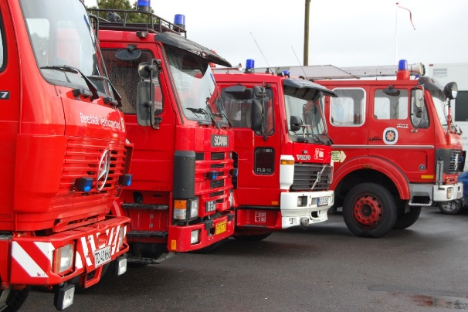
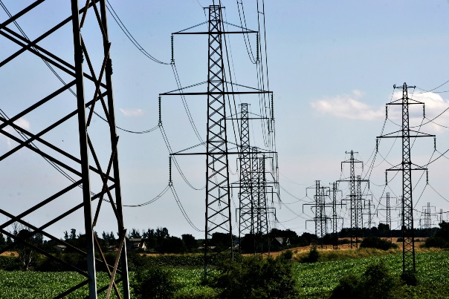
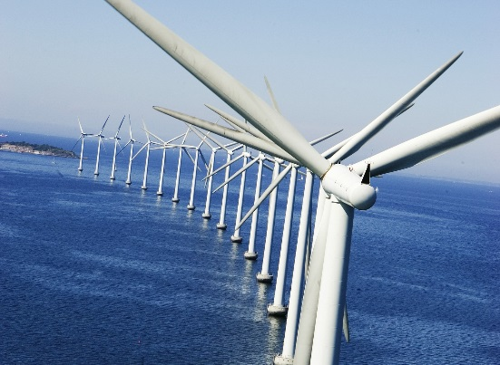
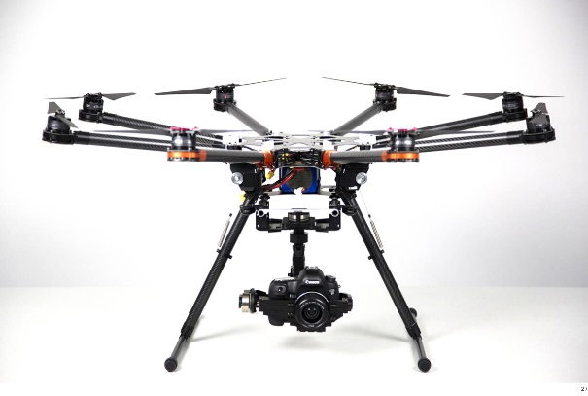
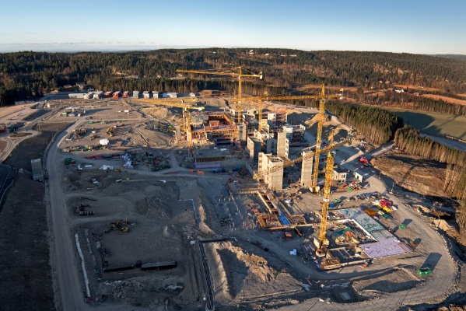
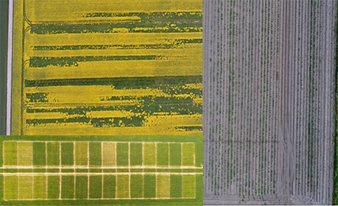
Industrial Applications
Exsampels on UAV’s implemented in an Industrial Application.
Notes:
Today drones are already implementet in firefigthing, inspection af power supply cables, windmills, construction site and farming.

Slide 4
Common Problem
Power Supply
Brand | Flight time
DJI Phantome II | 20 min
S1000 | 15 min
3DR RTF X8 | 12-13 min
ARF OktoXL 6S12 | 8-25 min
Comparing flight time for 4 Industrial UAV’s.
Notes:
A common problem for drones are the very short flight time.
All 4 drones are sold in industrial applications.
As we can see flight time is not impressing.

Slide 5
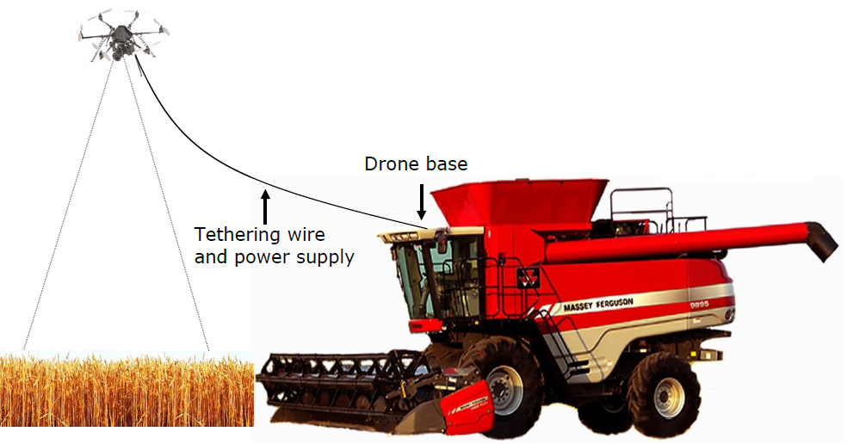
PTC - Platform for Tethered Control of UAV’s
Supply UAV with 120VDC@4.6A ~500W through a cable.
Loss in cable
Modeling the physics
Cartenary Chain
Thermodynamics
Design a practical solution
How to roll cable in/out
Storing of cable
Implement and test
Test designs and compare
Notes:
Outline of what i want to do with this thesis.
550W at the UAV end
Heating in drum/storing

Slide 6
Roadmap
Analysis
Design
Implementation
Test & Quality Control
Analyze Results
Milestones
3/10 Work Breakdown Structure
10/10 Propose Design solution
24/11 Testing and Implementation done
23/1 Hand in Thesis

